Slide 1

2024 Lorain County
Junior Fair Sponsors
Thanks for your support!

Slide 2
Premier Sponsors

Slide 3


Slide 4


Slide 5


Slide 6

Dr. Frank Krupka

Slide 7

Wellington & Ashland , Ohio
440-647-4659

Slide 8


Slide 9


Slide 10


Slide 11


Slide 12
Gold Sponsors

Slide 13
Hickory Grove Farms
The
McConnell Family

Slide 14
Spencer Feed & Supply
www.spencerfeed.com

Slide 15


Slide 16
Spreng Veterinary Services
William Spreng DVM
Wellington, Ohio

Slide 17

Firelands FFA

Slide 18


Slide 19


Slide 20
John & Lisa Piwinski
Mike, Amy & Ethan Piwinski

Slide 21


Slide 22


Slide 23


Slide 24
Ortner Farms

Slide 25


Slide 26

Wellington Masonic Lodge #127

Slide 27


Slide 28

736 S. Main Street Wellington, Ohio 44090
440-647-4669
Manager - Madison Bremke

Slide 29


Slide 30


Slide 31


Slide 32


Slide 33


Slide 34


Slide 35

Denes Concrete Inc.
Wellington, Ohio

Slide 36

Polk, Ohio

Slide 37
AM Grain Farms LLC.

Slide 38
Denes Excavating LLC.

Slide 39
Silver Sponsors

Slide 40


Slide 41


Slide 42


Slide 43
Tim & Ann Buchs

Slide 44


Slide 45


Slide 46


Slide 47

AgCREDIT
FARMS HOMES | LAND

Slide 48


Slide 49


Slide 50


Slide 51


Slide 52
Ridge Meadow Farms

Slide 53


Slide 54


Slide 55


Slide 56


Slide 57


Slide 58
J.D.’s Mums & More
Bryan & Jessica Doehr Family
Penfield, Ohio

Slide 59
Jaloda Farm LLC.
Jim Sheffield family
Pittsfield, Ohio

Slide 60
Mike Washburn Family
New London, Ohio

Slide 61

Vermilion Vet Clinic
Categories
Pet Services/Supplies

Slide 62


Slide 63
Lauren Storrow, Realtor Howard Hanna

Slide 64
Friends of Jr Fair Sponsors

Slide 65
Jordan Snowplowing
Chris & Melinda Jordan

Slide 66


Slide 67


Slide 68
Craig & Becky Norton
Brighton, Ohio

Slide 69
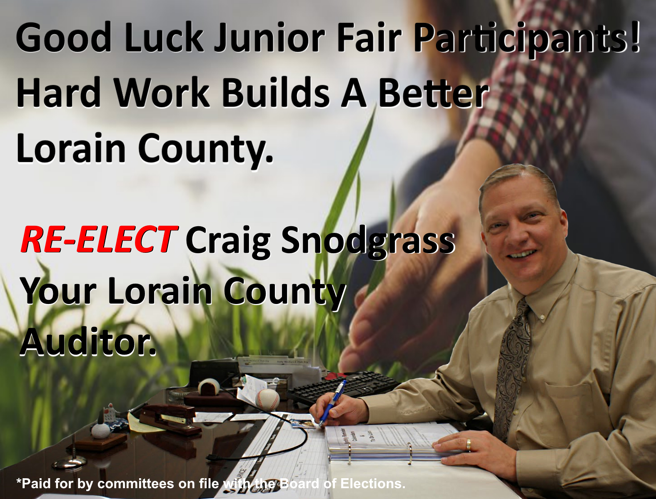

Slide 70
Woodrum Farms
Camden, Ohio

Slide 71
Senghas Construction

Slide 72


Slide 73

State Representative
Joe Miller

Slide 74

Gossman Allstate Insurance
Wellington & Elyria, Ohio

Slide 75


Slide 76
BRILL-VIEW FARMS INC
Rick & Janice Brill Family
Wellington, Ohio

Slide 77
Cheri’s Touch Interiorscapes
Cheri Heffernan

Slide 78

Grobe Fruit Farm Ltd.
Elyria, Ohio

Slide 79
In Memory of Oran Williams
The Williams Family

Slide 80
Kodiak Construction Inc.
Avon, Ohio

Slide 81
Mark Diedrick Family
Pittsfield, Ohio

Slide 82
Wellington FFA

Slide 83
B & K Motorsports

Slide 84
Hickory’s Legacy Farms, LLC

Slide 85
Black River FFA

Slide 86

Grafton Grangers 4-H Club

Slide 87
Bob & Sandy Diedrick Family
Pittsfield, Ohio

Slide 88
Vaughn & Brenda Stump
Wellington, Ohio

Slide 89
Ricky Bob’s Popcorn

Slide 90
Robert, Elaine & David Beekman

Slide 91
Russ & Denise Breyley Family

Slide 92


Slide 93
Kiley Tree & Bucket Service
Jon & Amy Kiley

Slide 94

Lagrange, Ohio

Slide 95
B & K Motorsports

Slide 96
Savarino’s Garage

Slide 97
We thank our sponsors for their support!

